Slide 1
X-HALE ATV Ground Vibration Testing Review
02/25/2020
Bilal Sharqi

Slide 2
Overview
Setup and preliminaries
Numerical model updates
Experimental setup
Experimental data collected and settings
FRFs
Poles
Results tables and mode shapes

Slide 3
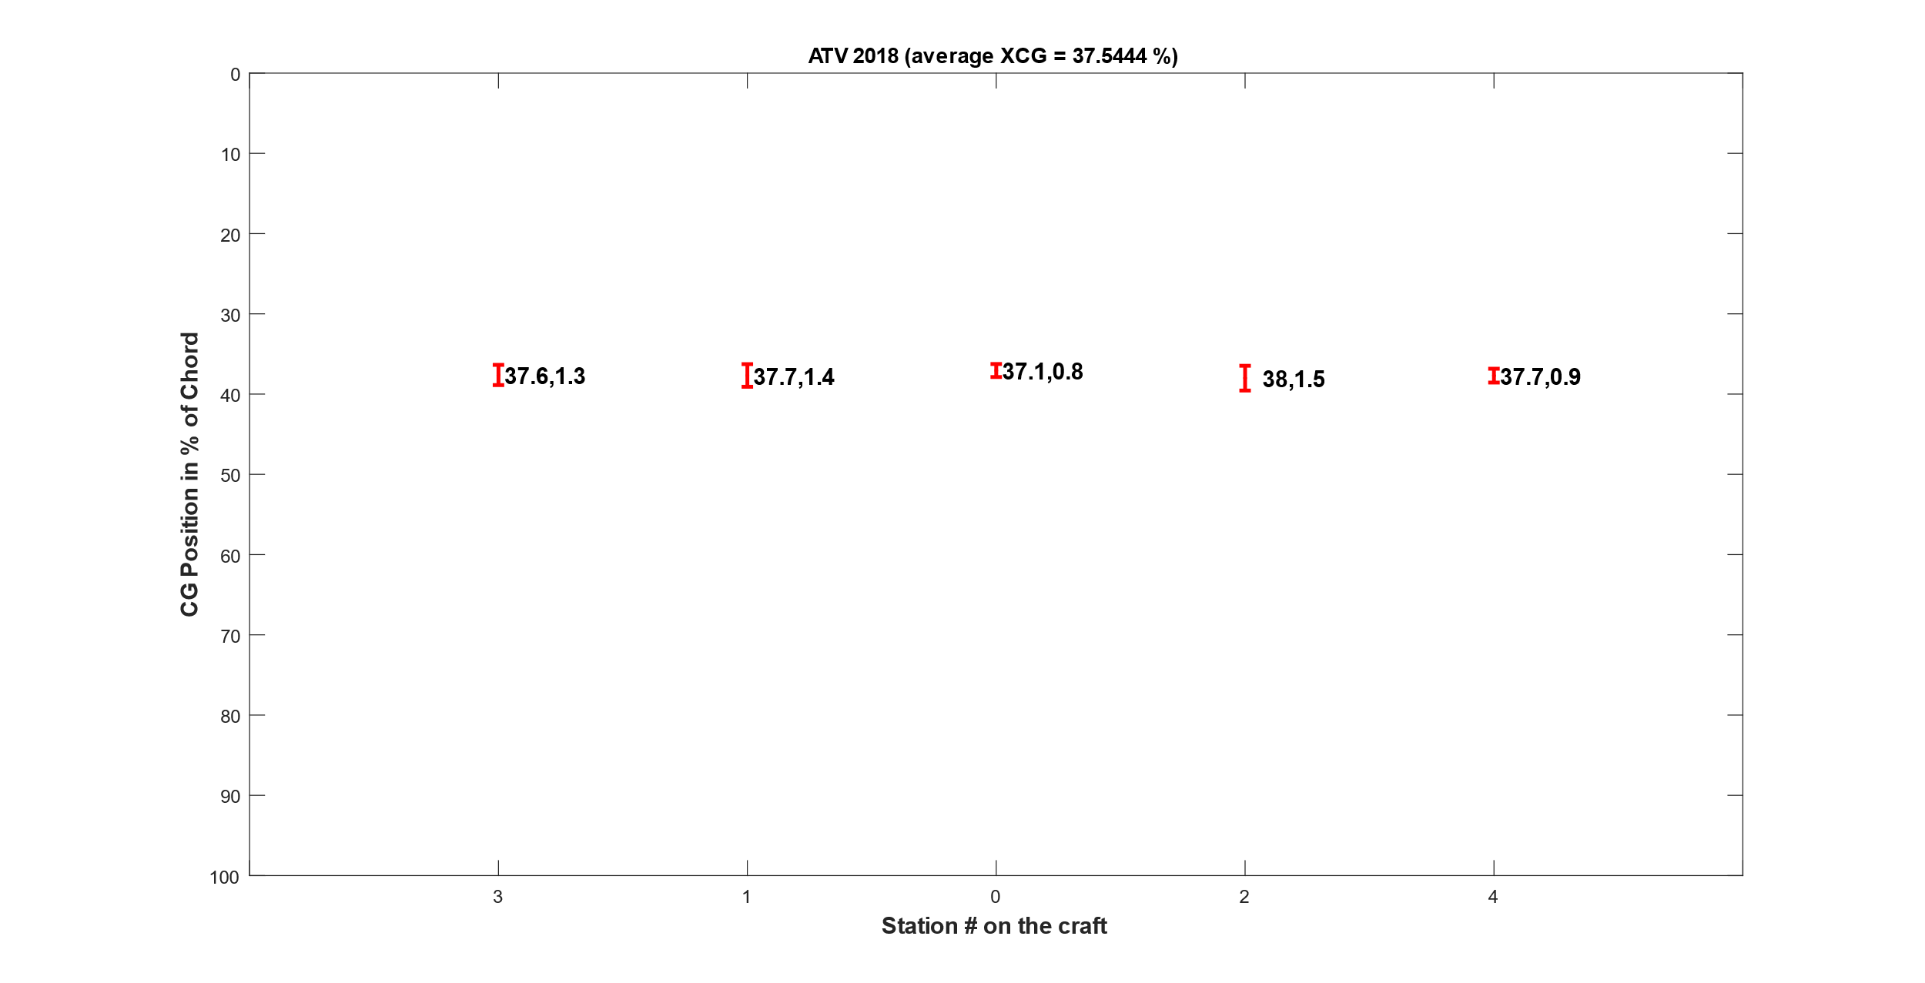
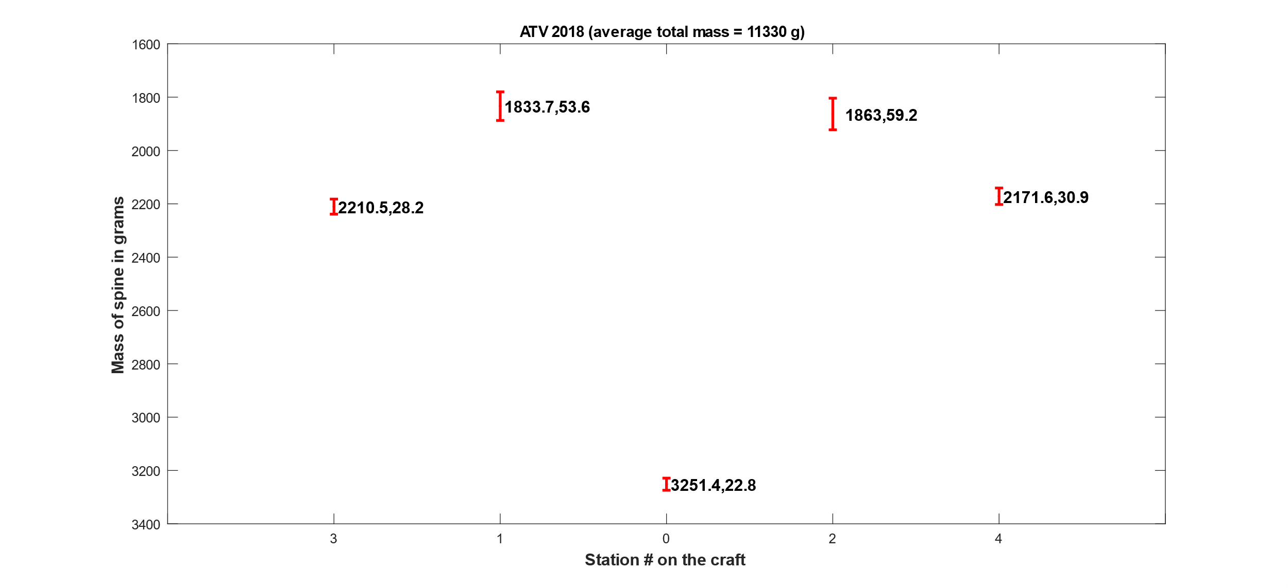
Mass and C.G. matching – actual measurements
Overall Trends
 | ATV
Total Mass [g] | 11330.2
XCG | 37.5%
YCG | -2.1%
Spine 3 | 2210.5
Spine 1 | 1833.7
Spine 0 | 3251.4
Spine 2 | 1863.0
Spine 4 | 2171.6
Individual spine station mass; and standard deviation for 10 trials
Individual spine cg; and standard deviation for 10 trials

Slide 4
Mass and C.G. matching – numerical model
Started with an X-HALE FEM - Nastran input file – that was defined from a UM/NAST X-HALE input file in 2014-2015
Modified mass and c.g. for each spine and corrected masses for
Fins
Tails
Cameras
Did not update inertias and stiffnesses since I do not have access to the individual spines and wings on the ATV to obtain measurements – left as an exercise for future optimization
 |  | Initial model | Updated model | Actual | % difference
 | Mass [g] | 10861.9 | 11330.8 | 11330.2 | 0.0%
Value [m] | X c.g. | 0.06621 | 0.07518 | 0.07500 | 0.2%
 | Y c.g. | -0.00095 | -0.00332 | -0.00420 | 20.9%
% chord | X c.g. | 33.1% | 37.6% | 37.5% | -
 | Y c.g. | -0.5% | -1.7% | -2.1% | -

Slide 5
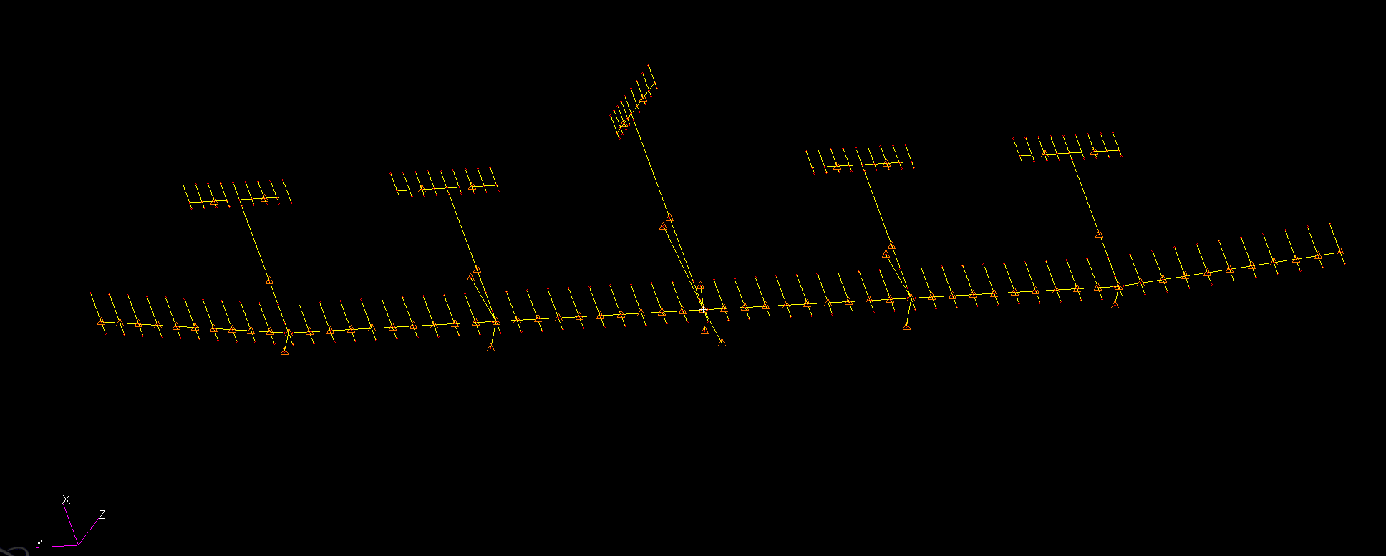
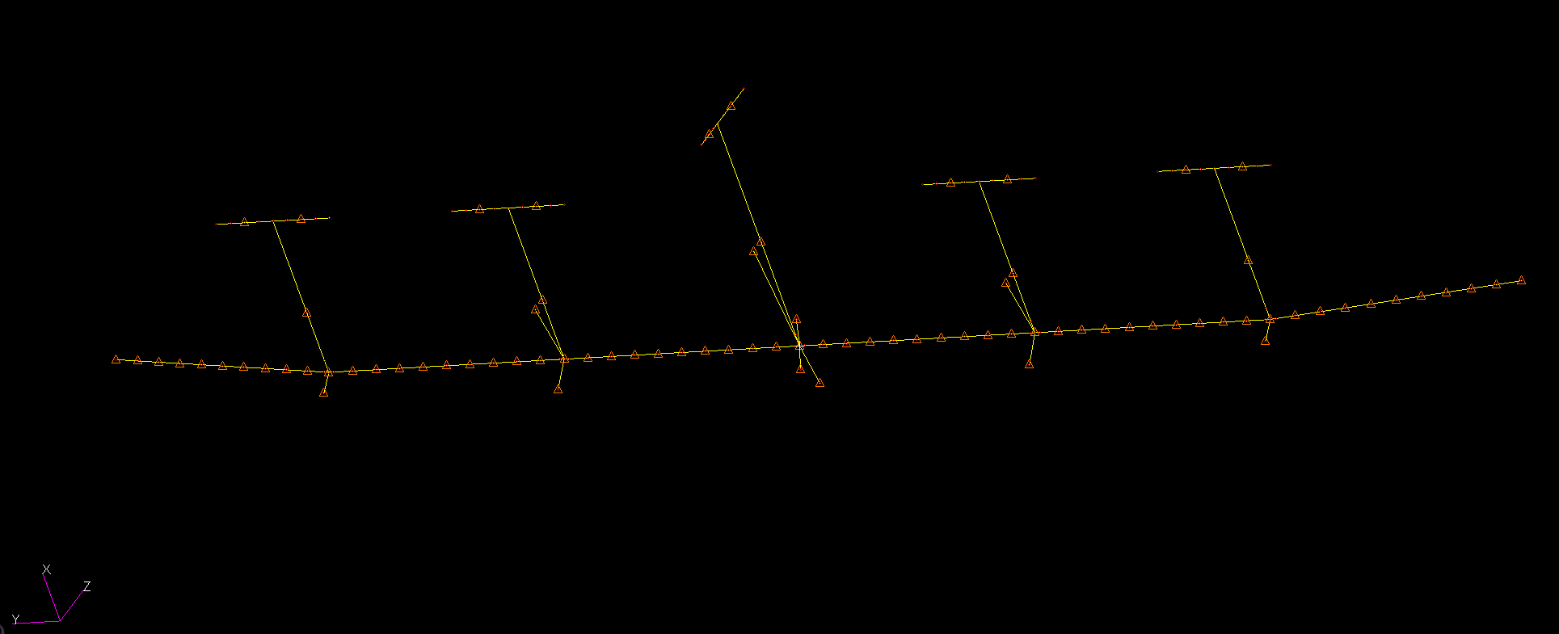
X-HALE Numerical Model
Beams added from c.g. (main wing beams) – used existing “stiff” material (used for spines/booms)
1 set of beams for TE
1 set of beams for LE
No mass associated with the additional beams
Notes:
Started with the numerical model of the X-HALE which had the wing and tails modeled as beams and had no chord length associated with them
Had difficulty visualizing torsion, so I added beams to represent the chord and to have a better sense of the c.g.

Slide 6
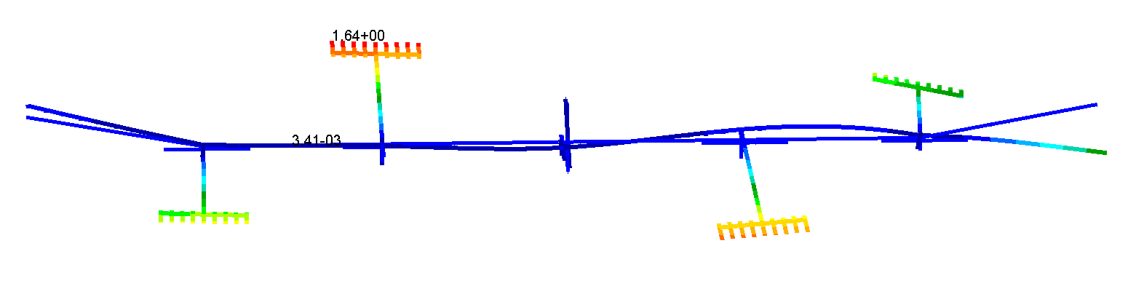
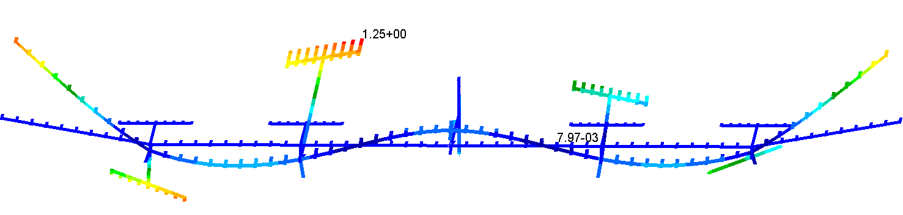
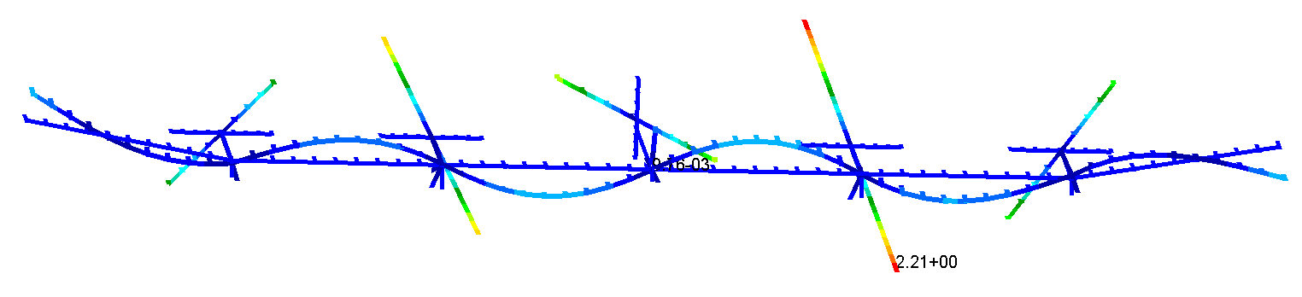
Modes from undeformed numerical solution
Mode # | SOL103 baseline | SOL103 (visualize torsion) | Mode Type | % Difference
1 to 6 | 0.00 | 0.00 | Rigid body mode | 0.00%
7 | 0.90 | 0.90 | 1 OOP | 0.00%
8 | 2.63 | 2.63 | 2 OOP | 0.00%
9 | 2.98 | 2.98 | Center tail bending | 0.00%
10 | 3.08 | 3.08 | Weird pitching mode | 0.00%
11 | 3.50 | 3.50 | 1 T | 0.00%
12 | 4.38 | 4.38 | 3 OOP + 2 T | 0.00%
13 | 4.62 | 4.62 | Tails rotating around Z | 0.00%
14 | 4.64 | 4.64 | 3 T | 0.00%
15 | 4.70 | 4.70 | Tails mode | 0.00%
16 | 4.76 | 4.76 | 3 OOP + 2 T | 0.00%
17 | 4.80 | 4.80 | Tails mode | 0.00%
18 | 4.98 | 4.98 | Tails mode | 0.00%
19 | 6.87 | 6.87 | 1 IP | 0.00%
20 | 7.61 | 7.61 | 4 OOP | 0.00%
21 | 8.66 | 8.66 | 5 OOP | 0.00%
22 | 9.15 | 9.15 | Weird pitching mode | 0.00%
23 | 10.86 | 10.86 | 2 IP | 0.00%
24 | 14.53 | 14.53 | 2 IP + weird pitch | 0.00%
25 | 18.86 | 18.86 | 6 OOP + tail rotation | 0.00%
3 T : 4.64 Hz
3 OOP + 2 T : 4.76 Hz
Full structure modes highlighted
6 OOP + Tail : 18.86 Hz
To capture OOP modes up to 20 Hz, 7 stations of accelerometers strategically placed across the span would be enough
Notes:
The undeformed, unloaded (no accel or attachment mass), no springs, free-free modal analysis was used to determine and classify the initial modes and used to define accel locations and/or layout
The main, full airframe elastic modes are highlighted, and the others are component modes like tail dominant modes and/or some other modes I cannot classify like pitch modes

Slide 7
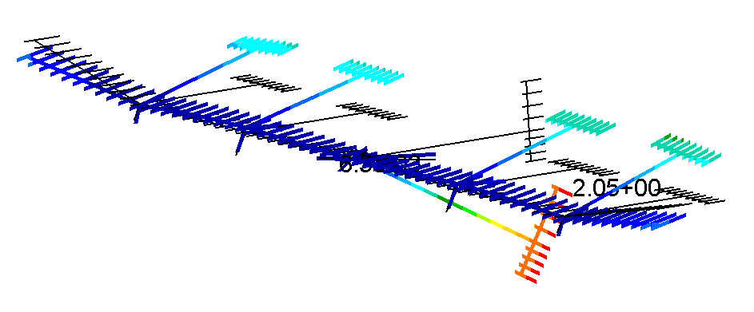
Weird pitching mode 3.08 Hz – SOL103 undeformed

Slide 8
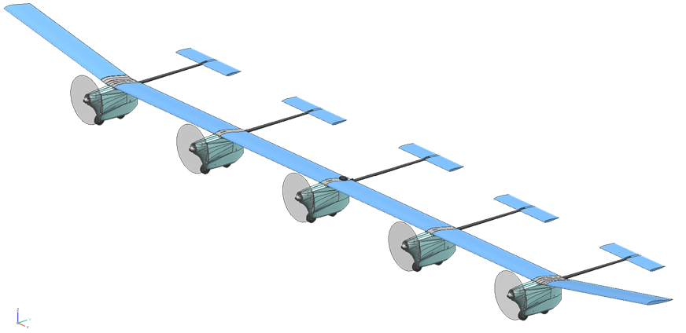
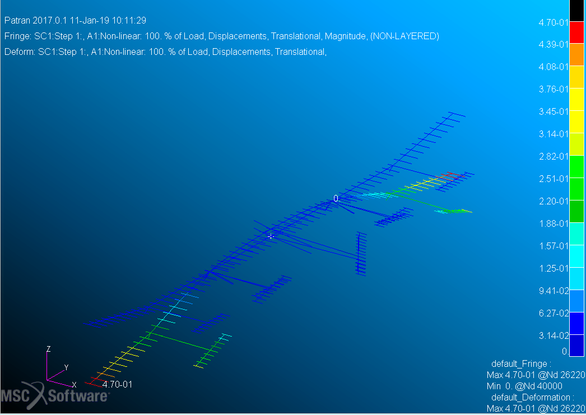
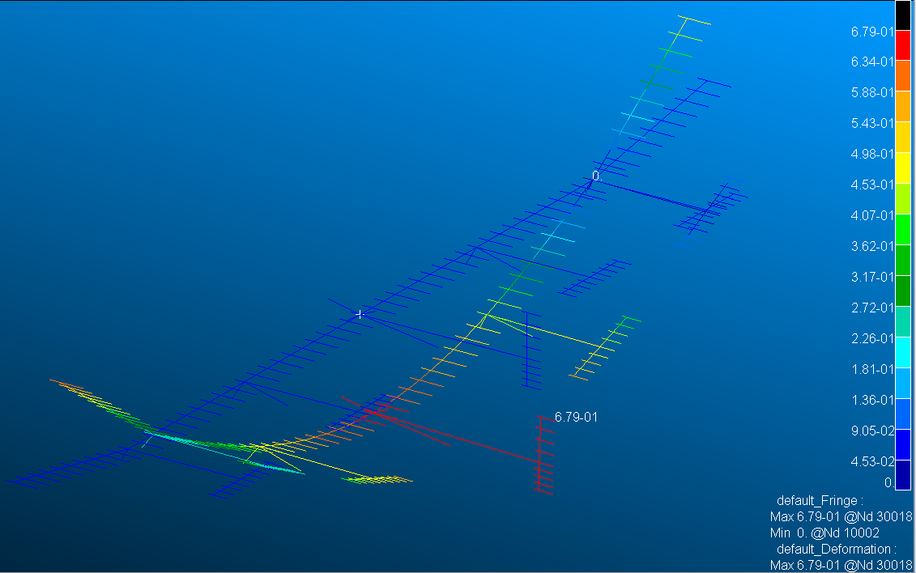
X-HALE deformed modal analysis (SOL400) process
Two configurations defined
Springs at outboard
Springs at inboard
2 Steps for the analysis (SOL 400)
STEP 1: Nonlinear static analysis
STEP 2: Deformed modal analysis
z
y
x
Inboard static deformation
Outboard static deformation
12356
12356
1356
1356
Notes:
Right : only the rotation around the x-axis is not constrained
Left : the translation along the y-axis and the rotation around the x-axis are not constrained

Slide 9
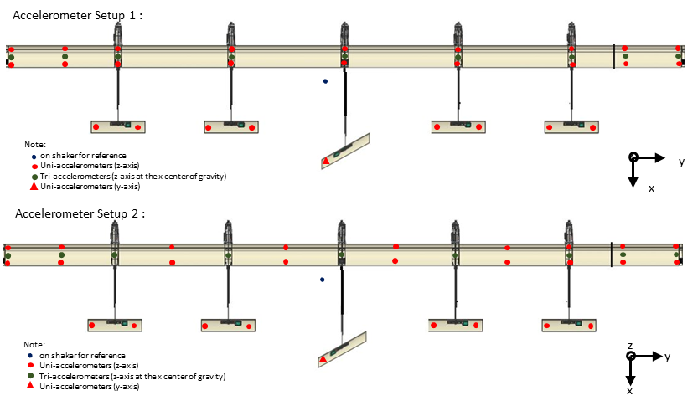
Accelerometer layout for tests done in the outboard configuration
A few notes
9 stations of uniaxial accelerometers along the span
Each station has one uniaxial accelerometer at the beginning of the wingbox (<5 cm from the Leading Edge) and one at the trailing edge
Two uniaxial accelerometers on each tail except the center
We had 28 uniaxial accelerometers in the lab – Used all of them
Triaxial accelerometers placed along the aircraft c.g. – close to the end of the wingbox
This way, OOP, IP and Torsional vibrations should be captured
Also, this means 28 channels of data from uniaxial accelerometers and 27 channels of data from 9 triaxial accelerometers. Our DAQ (Siemens LMS SCADAS) has 56 channels of data acquisition

Slide 10
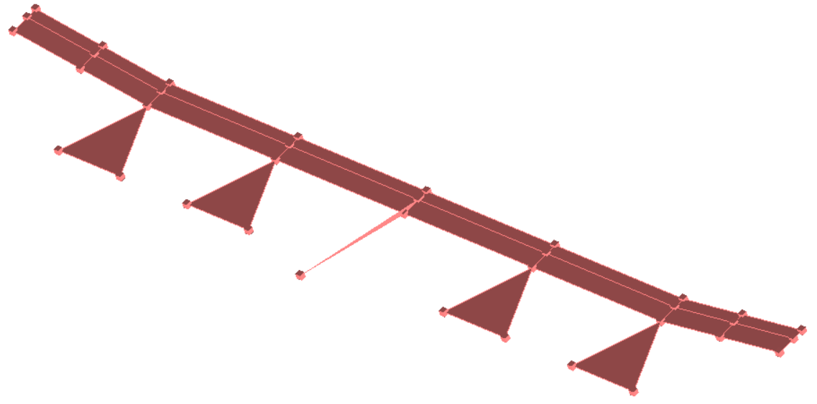
Outboard shape was tested first: Accel layout 1
LMS setup for accel layout 1 used for outboard tests
Accelerometers at each wing junction and 1 accelerometer on the vertical tail
The forward uniaxial accelerometer is placed at the beginning of the wingbox – flat surface
Triaxial at the end of the wingbox – at c.g. (7.5 cm from LE)
Rear uniaxial at the trailing edge (small angle)

Slide 11
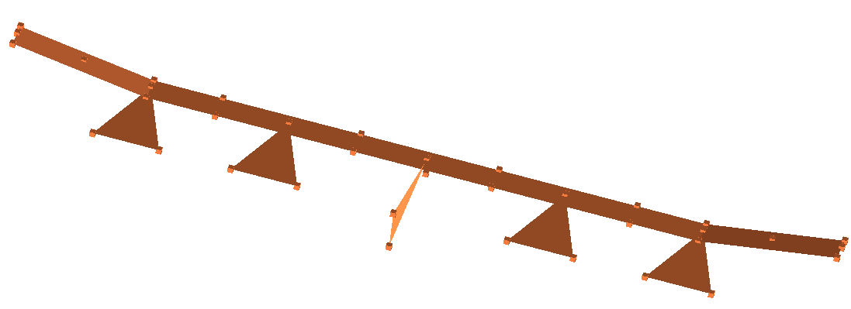
Outboard shape was tested first: Accel layout 2
Some notable deviations from the original definition
Outboard wings do not have a uniaxial station at the middle
This is because one of the sensors was failing and I had difficulty diagnosing/fixing it immediately, so I moved that station of accelerometers to the junction of the wings, and put an additional uniaxial accel on the vertical tail

Slide 12
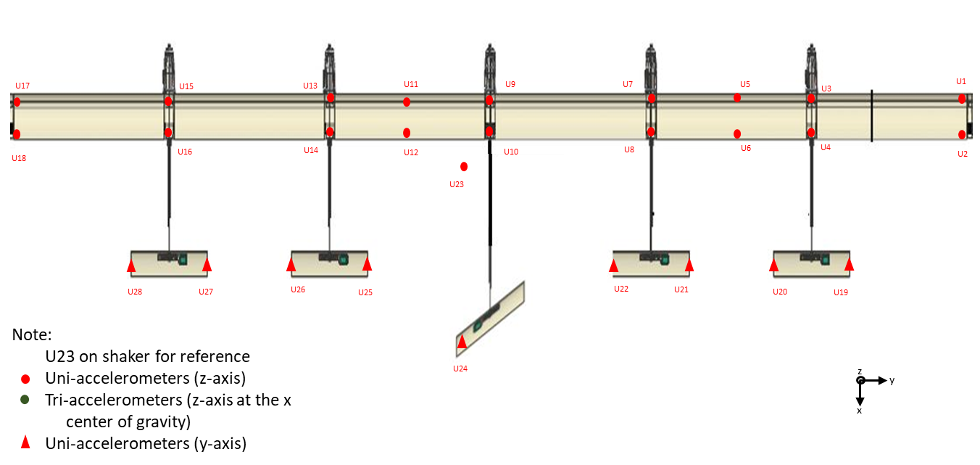
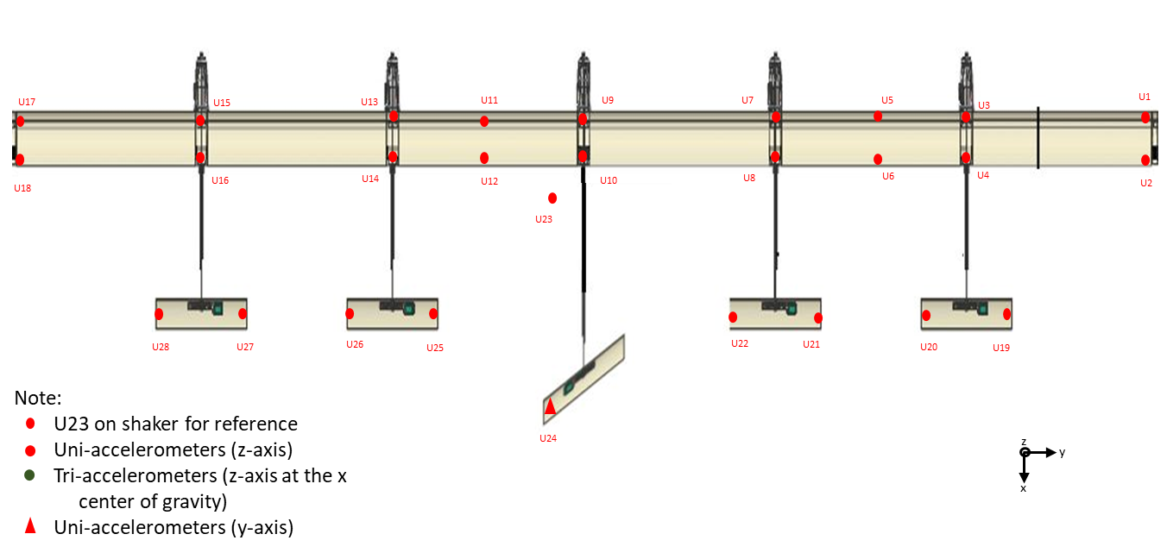
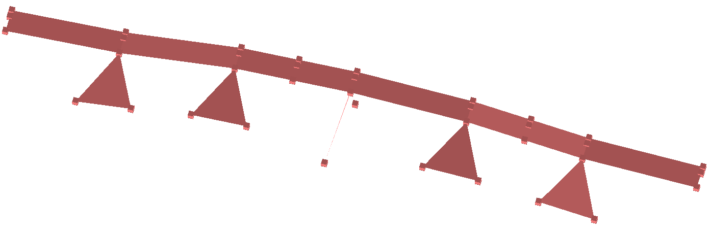
Accelerometer layout inboard tests
Introduced some asymmetry for the inboard tests in the accelerometer layout
Intention - improving peak resolution
Did not think of comparing experimental accelerometer layout of inboard vs outboard for mode shape comparison as much as against numerical data for each shape
First layout had tail accelerometers facing y axis (for lateral motion) – based on conversation with Prof. Cesnik during one of the lab tours
Second layout had tail accelerometers facing z (for vertical motion) to maintain consistency with previous tests and help visualize mode shapes

Slide 13
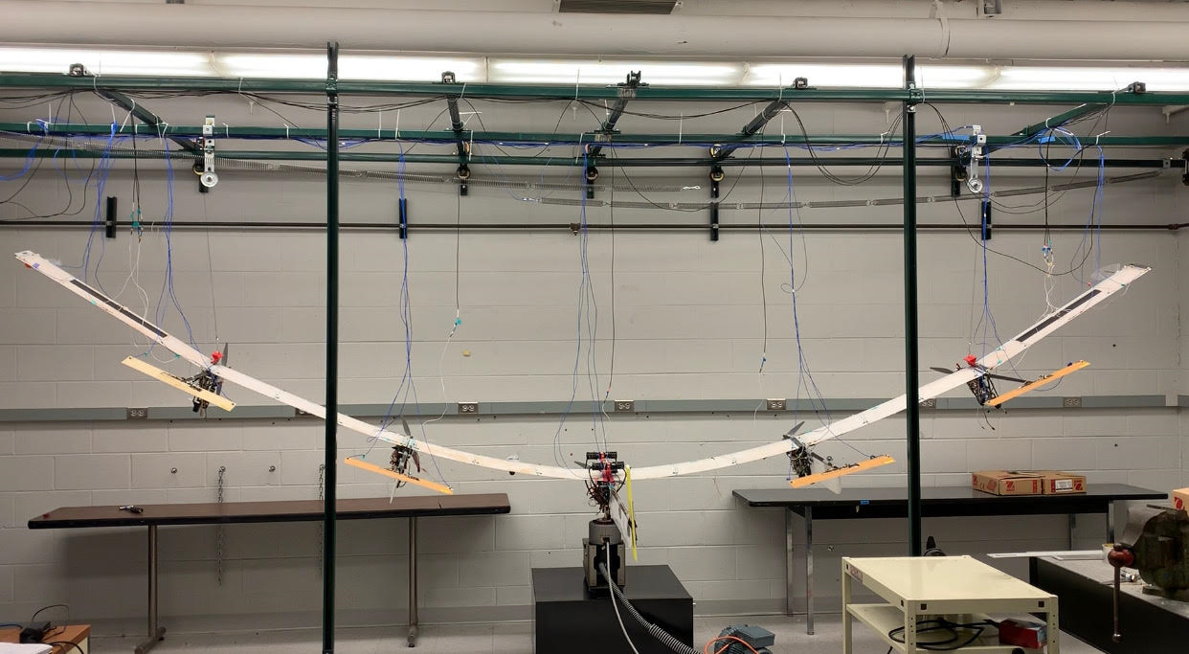
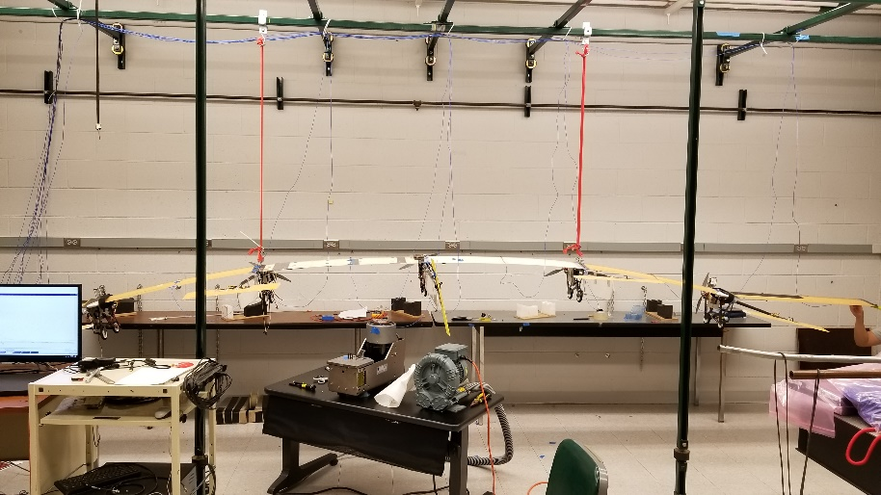
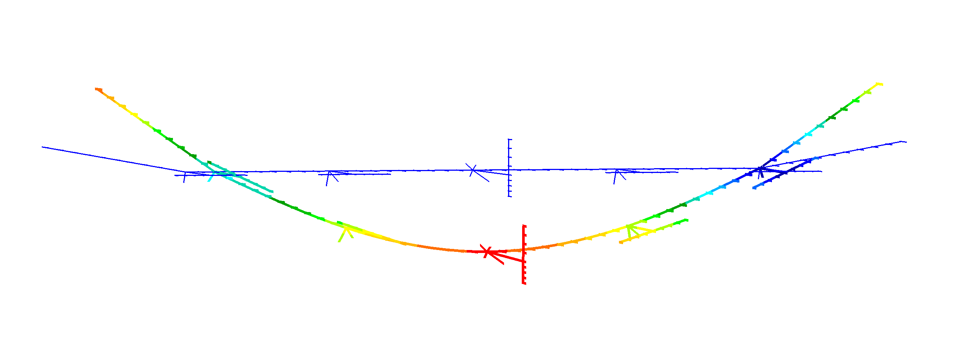
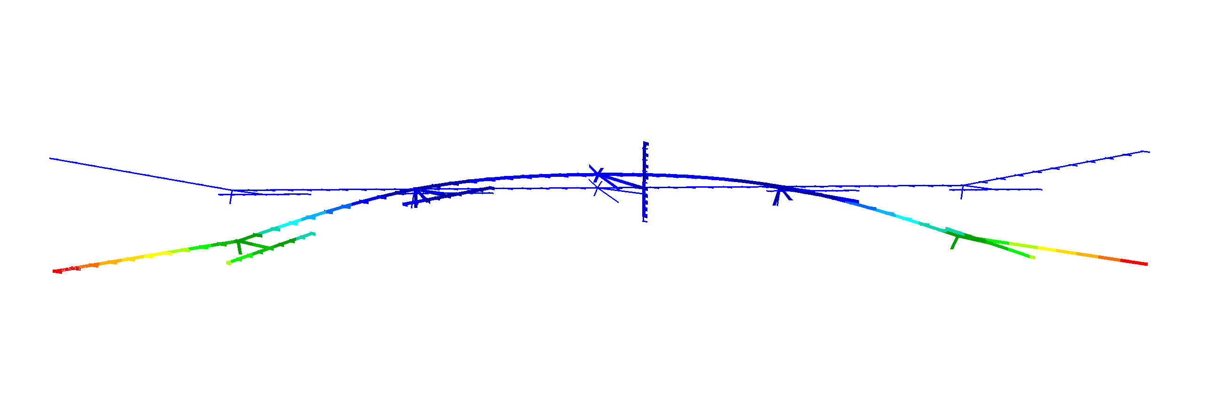
X-HALE suspended from GVT rig
Outboard configuration
Inboard configuration
Common test attributes
For both shapes, each run was done using a stepped sine excitation
Multiple runs (at least two) were done for each test
Tests were performed using a linear sweep-up from low to high extrema with 10 periods at each step/interval
For both shapes I have more data collected than I am going to show because additional tests were done with fewer sensors turned on or to troubleshoot some malfunctioning sensors

Slide 14
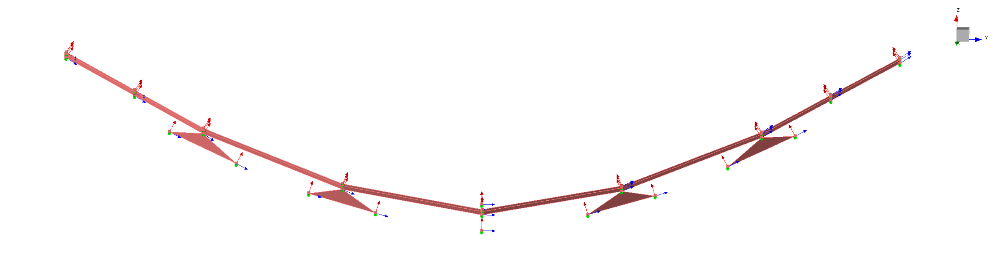
Updated Geometry - Outboard

Slide 15
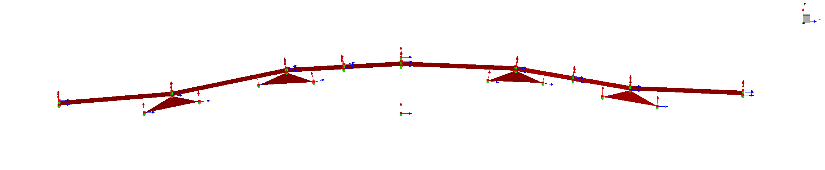
Updated Geometry - Inboard

Slide 16
Numerical results
 | SOL400 - 2step | SOL400 - 2step |  | SOL103
Type | Springs at Outboard | Springs at Inboard |  | Springs at Outboard
 | Numerical freq. [Hz] | Numerical freq. [Hz] | Difference | Numerical freq. [Hz] | Difference vs. SOL400
Vertical Translation | 0.27 | 0.27 | 1% | 0.27 | 1%
1st out-of-plane bending | 0.90 | 0.92 | 1% | 0.95 | 5%
2nd out-of-plane bending | 2.53 | 2.59 | 3% | 2.63 | 4%
Central tail bending | 2.94 | 2.94 | 0% | 2.98 | 1%
1st torsion | 3.32 | 3.47 | 4% | 3.50 | 5%
2nd torsion | 4.25 | 4.27 | 0% | 4.38 | 3%
3rd torsion | 4.47 | 4.52 | 1% | 4.64 | 4%
3rd out-of-plane bending | 4.25 | 4.68 | 9% | 4.76 | 11%
1st in-plane bending | 5.09 | 5.88 | 13% | 6.87 | 26%
4th out-of-plane bending | 7.15 | 7.53 | 5% | 7.62 | 6%
5th out-of-plane bending | 8.31 | 8.49 | 2% | 8.66 | 4%

Slide 17
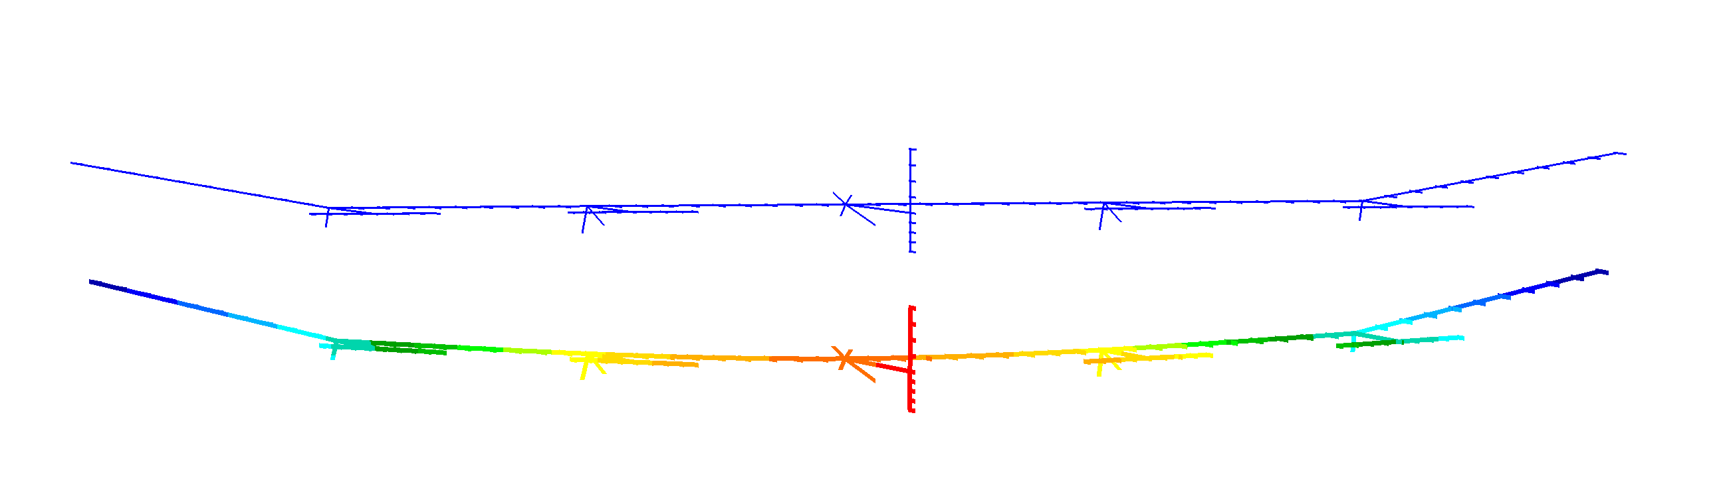
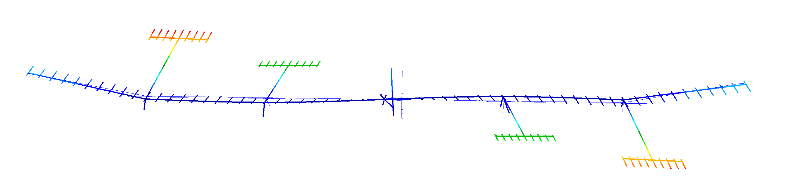
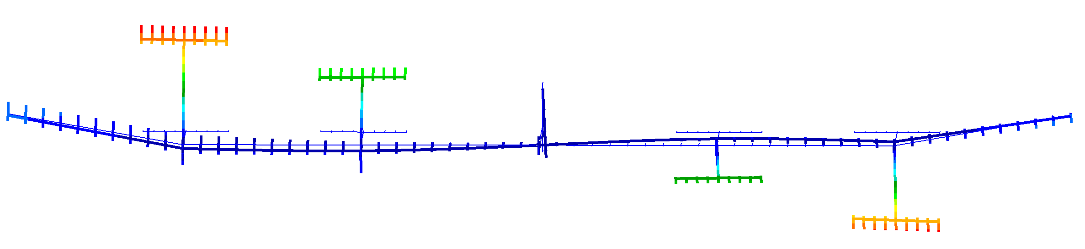
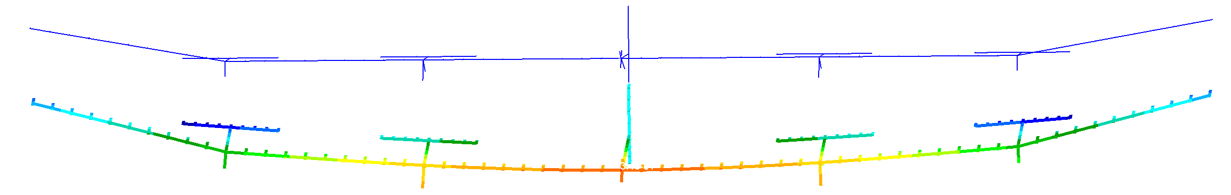
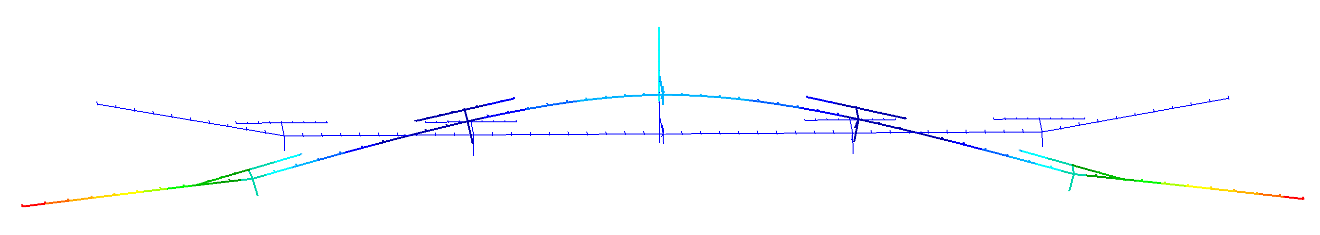
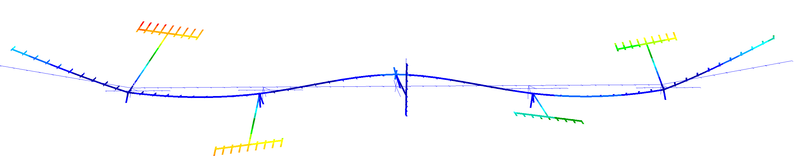
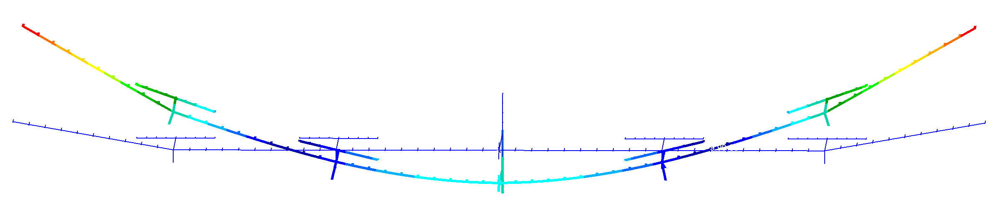
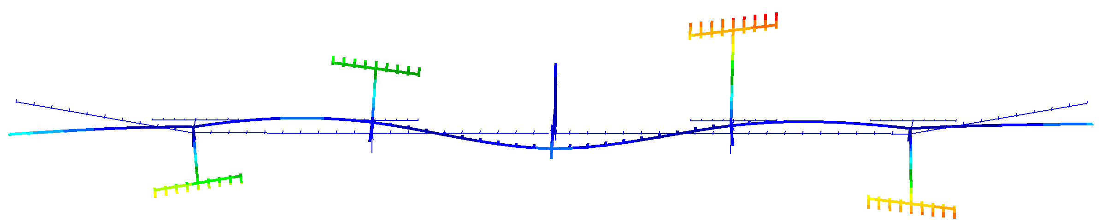
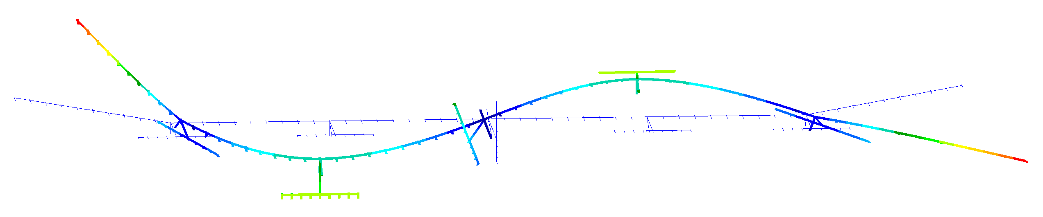
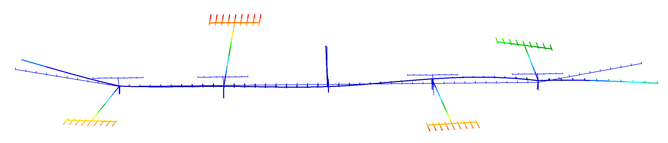
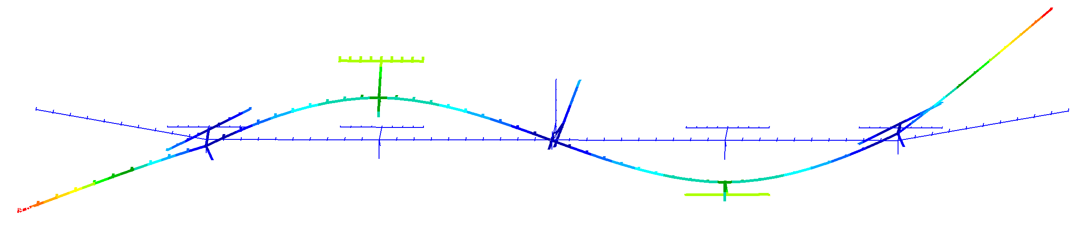
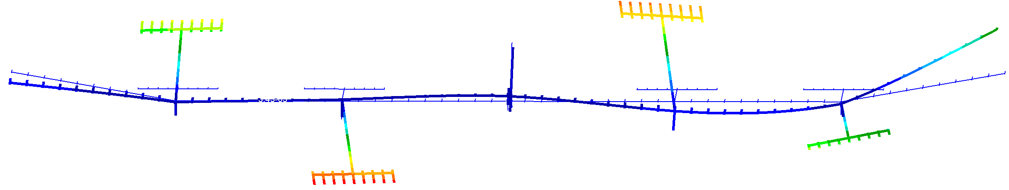
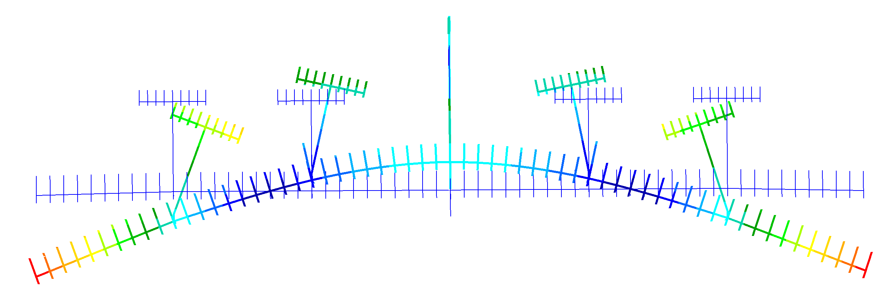
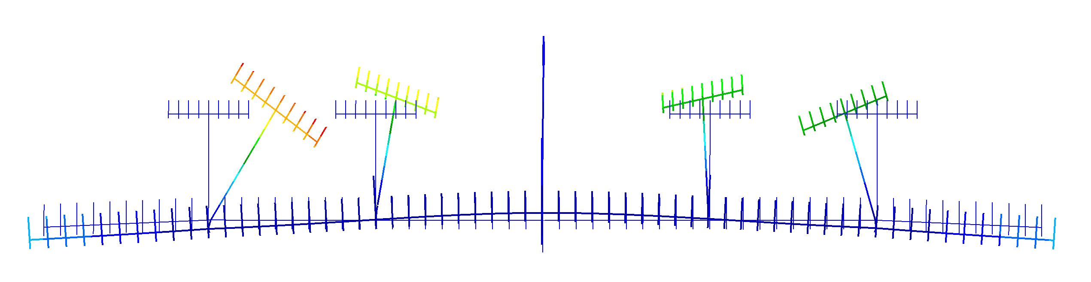
Mode shapes (outboard suspension) – deformed SOL400 vs SOL103
Plunge : 0.27 Hz
1st Torsion : 3.39 Hz
Plunge : 0.27 Hz
1st Torsion : 3.50 Hz
1st out-of-plane bending : 0.96 Hz
3rd out-of-plane bending/2nd Torsion : 4.34 Hz
1st out-of-plane bending : 0.95 Hz
3rd out-of-plane bending/2nd Torsion : 4.39 Hz
2nd out-of-plane bending : 2.55 Hz
3rd torsion : 4.61 Hz
2nd out-of-plane bending : 2.63 Hz
3rd torsion : 4.64 Hz
1st in-plane bending : 6.87 Hz
1st in-plane bending : 5.19 Hz
Mode shapes from a deformed modal analysis – SOL400
Mode shapes – SOL103 – no gravity effects

Slide 18
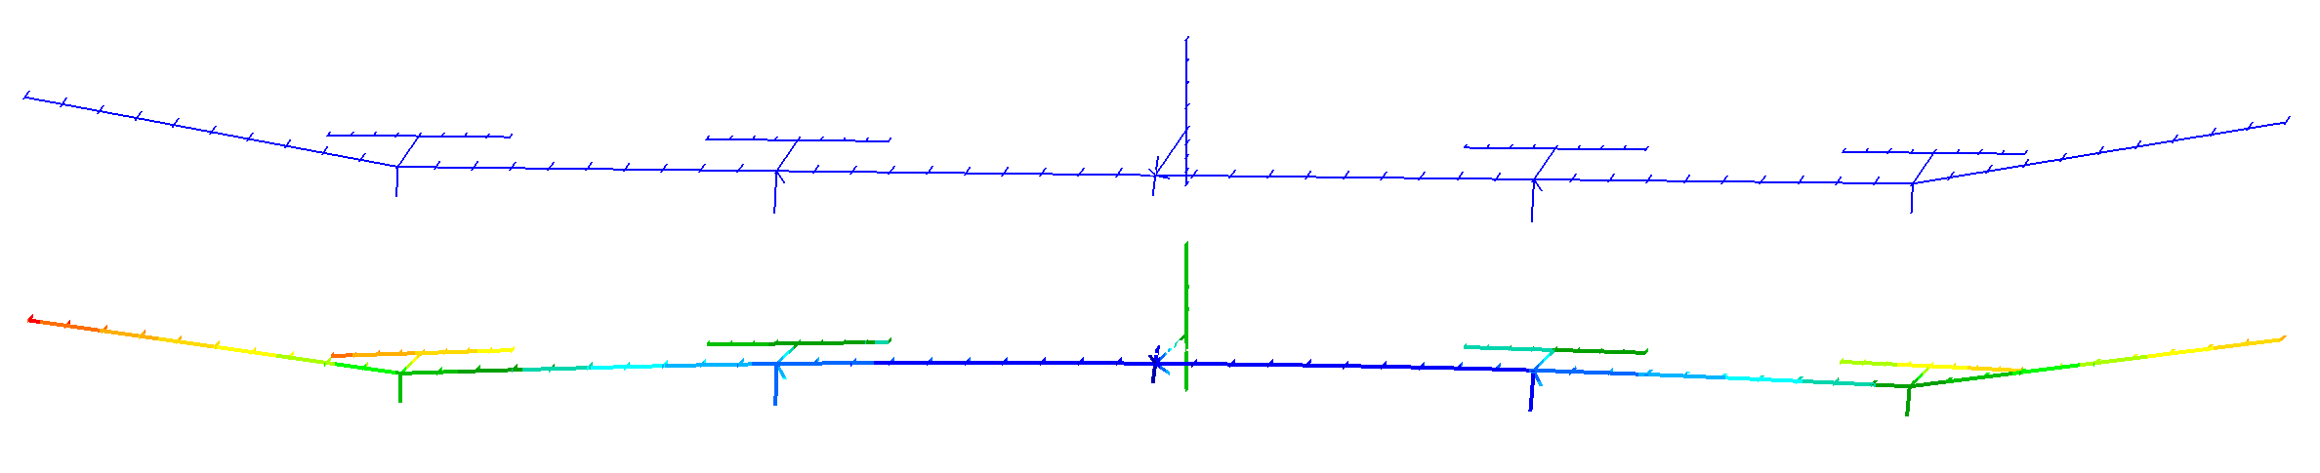
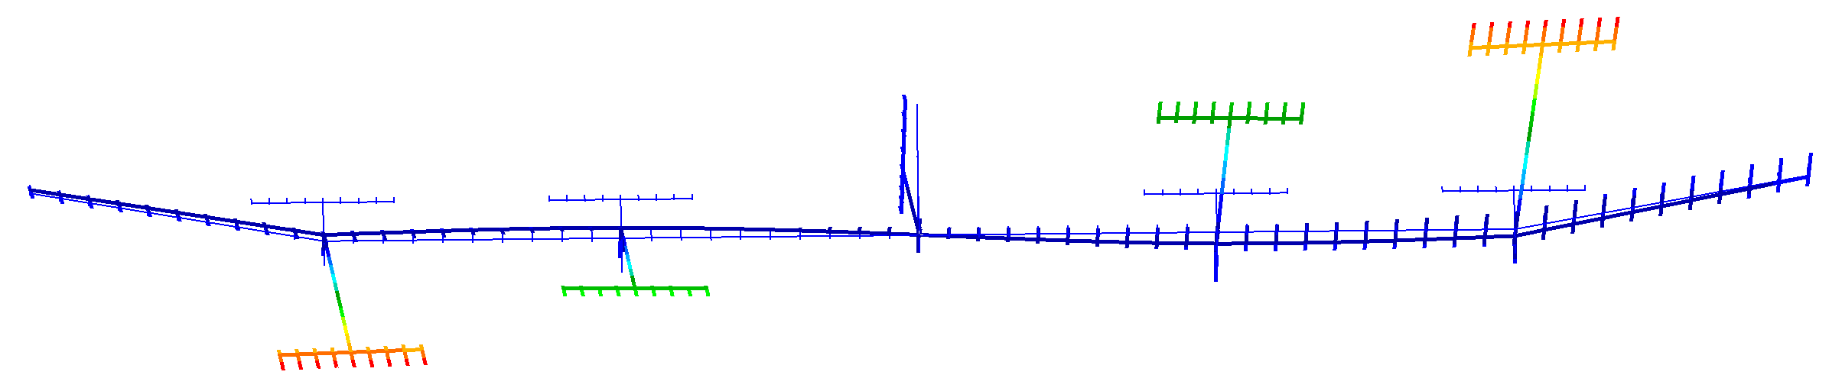
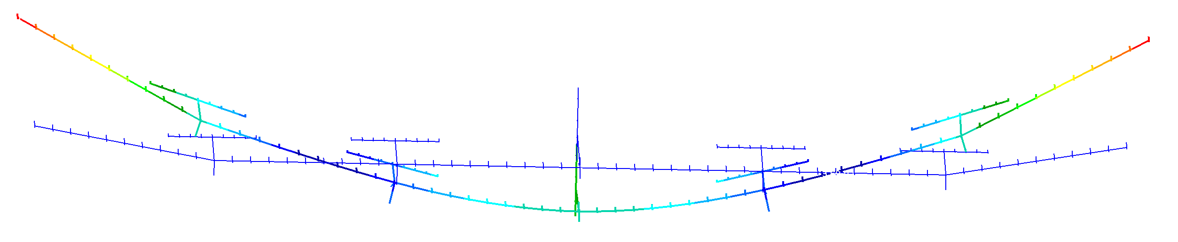
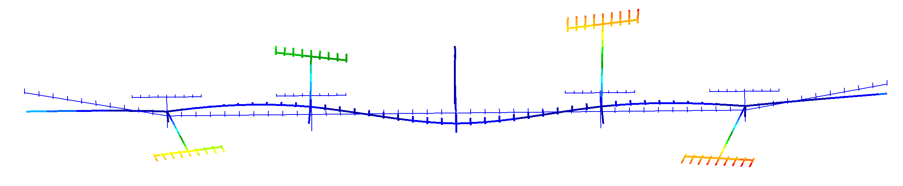
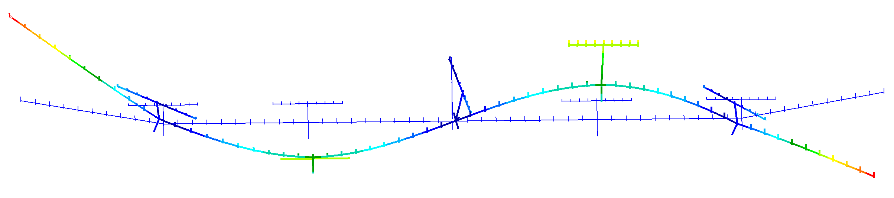
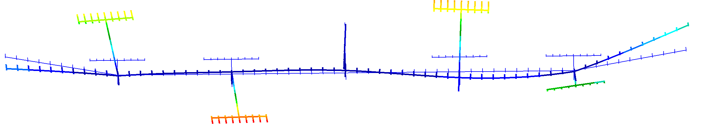
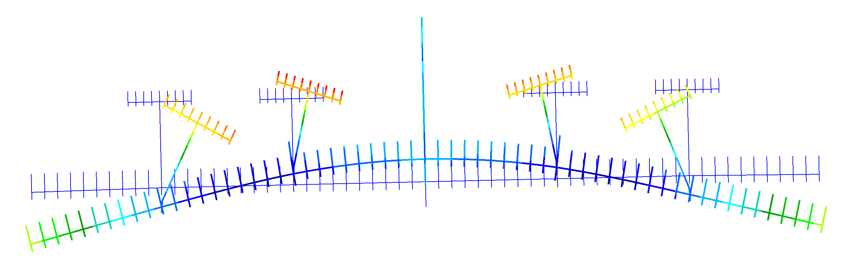
Mode shapes (outboard vs inboard suspension) - Deformed SOL400
Plunge : 0.27 Hz
1st Torsion : 3.39 Hz
Plunge : 0.28 Hz
1st Torsion : 3.56 Hz
1st out-of-plane bending : 0.96 Hz
3rd out-of-plane bending/2nd Torsion : 4.34 Hz
1st out-of-plane bending : 0.93 Hz
3rd out-of-plane bending/2nd Torsion : 4.39 Hz
2nd out-of-plane bending : 2.55 Hz
3rd torsion : 4.61 Hz
2nd out-of-plane bending : 2.67 Hz
3rd torsion : 4.66 Hz
1st in-plane bending : 5.19 Hz
1st in-plane bending : 6.1 Hz
Selected Mode shapes (from the outboard configuration)
Selected Mode shapes (from the inboard configuration)

Slide 19
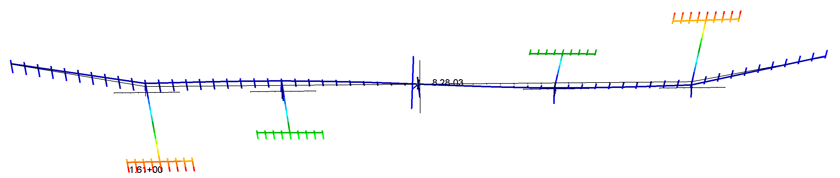
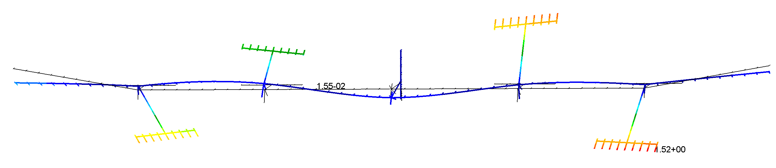
Torsional Modes
Inboard 1 T: 3.47 Hz
Inboard 2 T: 4.27 Hz

Slide 20
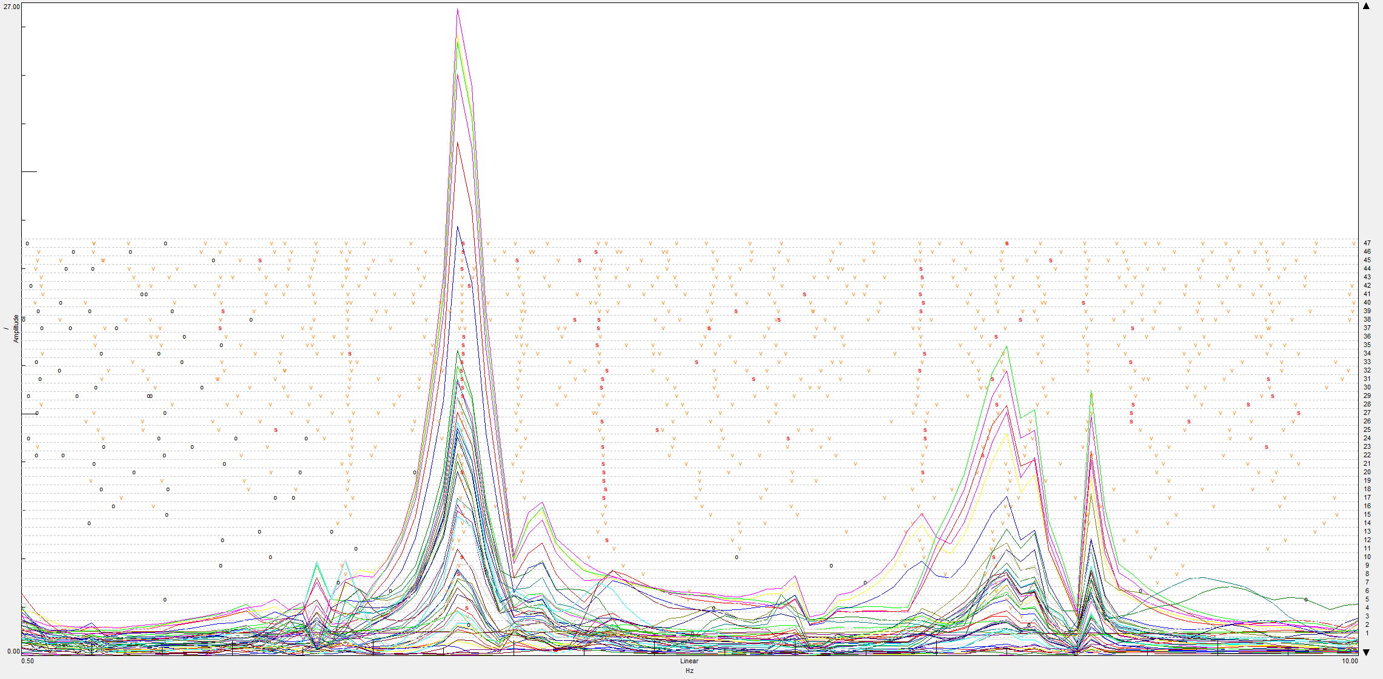
Outboard accel config 1, 0-10 Hz, 0.1 Hz step size, conventional (time MDOF) stabilization

Slide 21
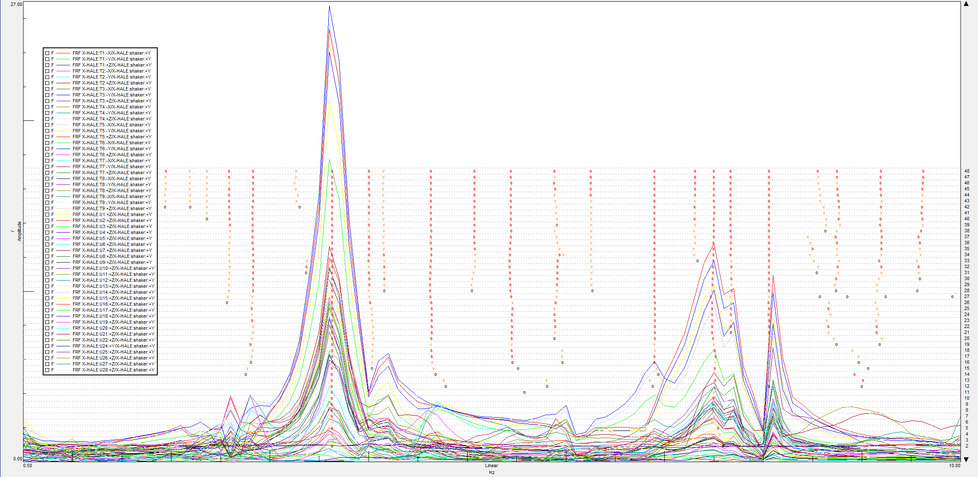
Outboard accel config 1, 0-10 Hz, 0.1 Hz step size

Slide 22
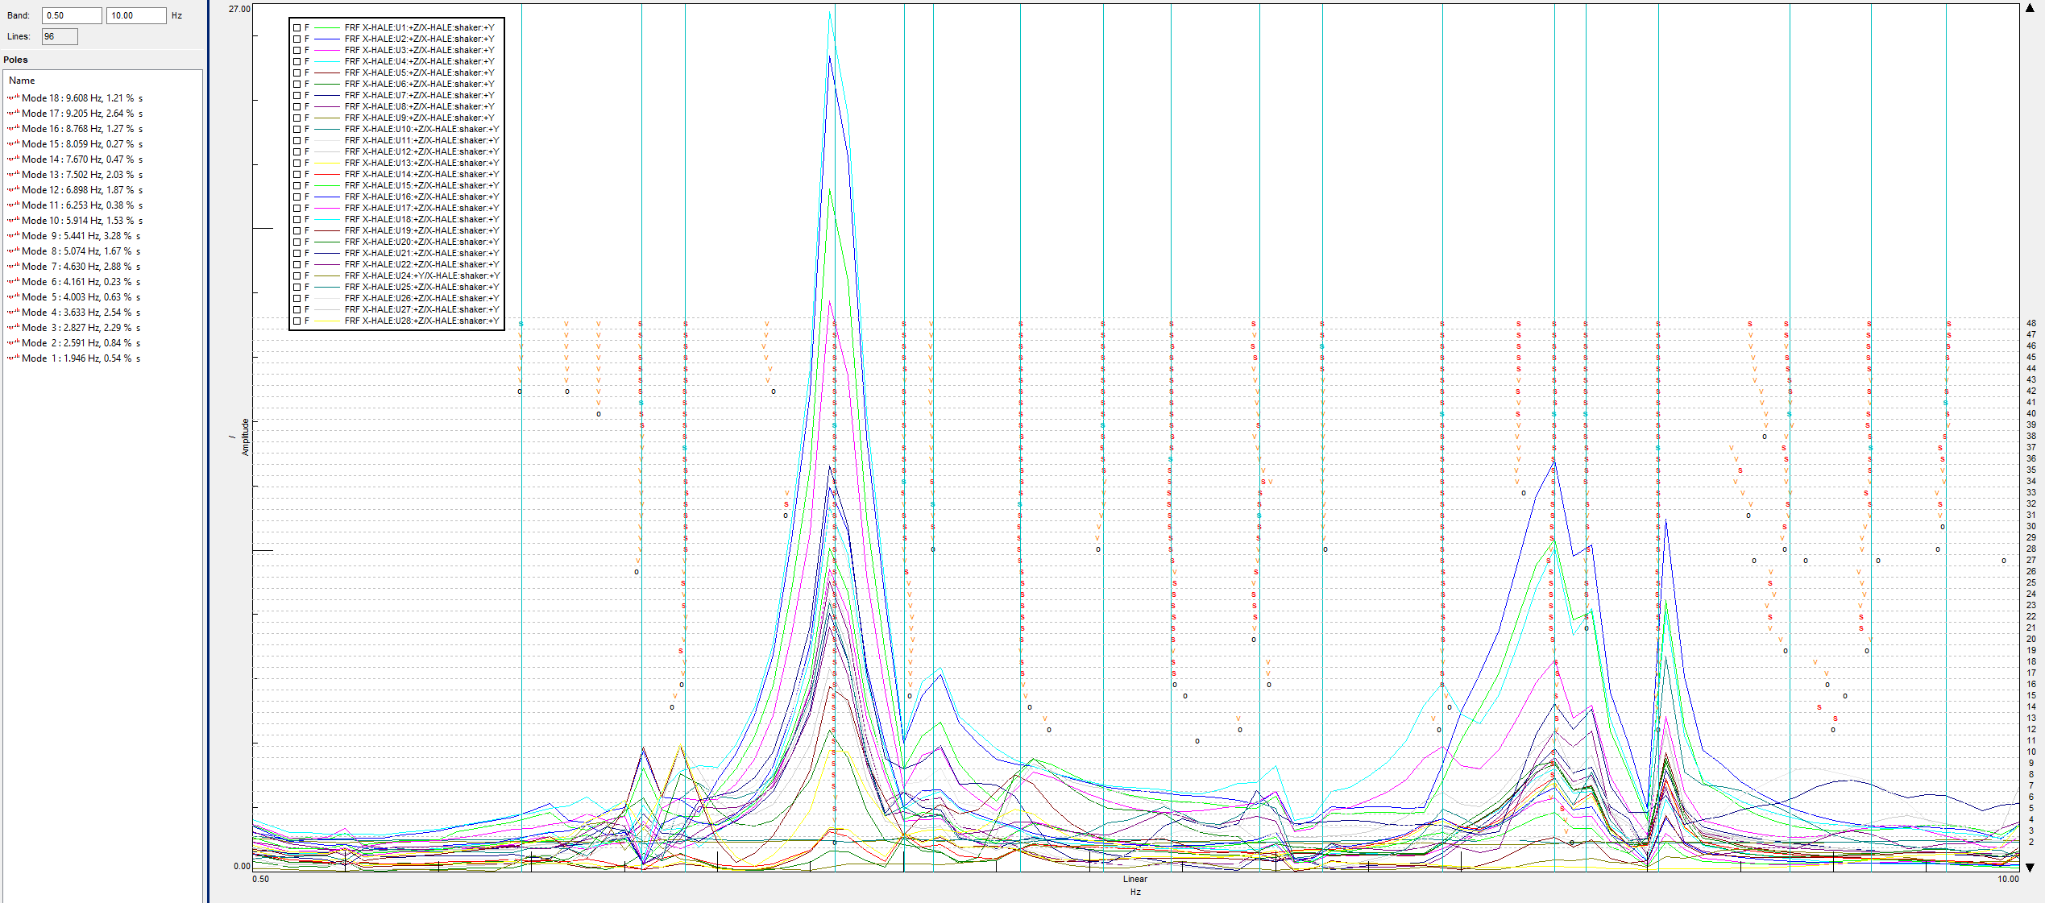
Outboard accel config 1, 0-10 Hz, 0.1 Hz step size, pole selection

Slide 23
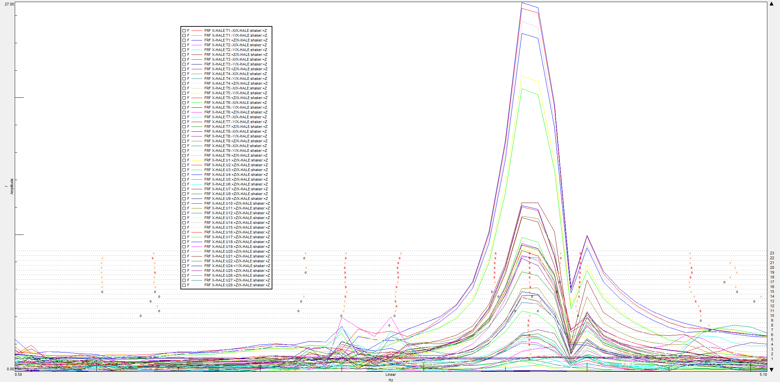
Outboard accel config 1, refined 0-5 Hz, 0.1 Hz step size

Slide 24

Outboard accel config 1, refined 0-5 Hz, 0.1 Hz step size, pole selection

Slide 25

Outboard accel config 2, 0-20.5 Hz, 0.05 Hz step size (only showing data up to 10 Hz)
T9 had a malfunction, which caused it to read and order of magnitude higher accelerations than the others

Slide 26

Outboard accel config 2, 0-20.5 Hz, 0.05 Hz step size (only showing data up to 10 Hz)
Same data, processed by excluding T9

Slide 27

Outboard accel config 2, 0-20.5 Hz, 0.05 Hz step size (only showing data up to 10 Hz), pole selection

Slide 28

Outboard accel config 2, 0-20.5 Hz, 0.05 Hz step size (only uniaxial accelerometers shown), run 2

Slide 29

Outboard accel config 2, 0-20.5 Hz, 0.05 Hz step size (only showing data up to 10 Hz), pole selection, run 2

Slide 30

Inboard (only uni-axials shown), 0-10 Hz, 0.05 Hz step size, conventional (time MDOF) stabilization

Slide 31

Inboard, 0-10 Hz, 0.05 Hz step size

Slide 32

Same Inboard data, with legend, 0-10 Hz, 0.05 Hz step size, tails accels in z

Slide 33

Inboard, 0-10 Hz, 0.05 Hz step size, tail accel in z, pole selection

Slide 34

Inboard, 0-10 Hz, 0.05 Hz step size, tail accel in y, pole selection

Slide 35
Results - Outboard
Mode type | Numerical freq. [Hz] | Num. with added attachment mass [Hz] | Avg. Exp freq. [Hz] | Ag. Exp damp. ratio [%] | STD Error freq. [Hz] | STD error damp. [%] | % Diff. num v. exp
1 OOP | 0.96 | 0.90 | 1.00 | 1.24 | 0.03 | 0.17 | 10%
2 OOP | 2.55 | 2.53 | 2.55 | 0.90 | 0.02 | 0.09 | 1%
1 T | 3.39 | 3.32 | 3.48 | 1.75 | 0.07 | 0.30 | 4%
2 T | 4.34 | 4.25 | 4.67 | 2.83 | 0.03 | 0.13 | 9%
3T | 4.61 | 4.47 | 5.10 | 1.49 | 0.02 | 0.09 | 12%
3 OOP/2 T | 4.34 | 4.25 | 4.11 | 0.94 | 0.02 | 0.18 | 3%
4 OOP | 7.32 | 7.15 | 6.99 | 1.74 | 0.07 | 0.09 | 2%
5 OOP | 8.41 | 8.31 | 8.08 | 0.75 | 0.01 | 0.25 | 3%
1 IP | 5.19 | 5.09 | - | - | - | -

Slide 36
Results - Inboard
Mode type | Numerical freq. [Hz] | Num. with added attachment mass [Hz] | Avg. Exp freq. [Hz] | Avg. Exp damp. ratio [%] | STD Error freq. [Hz] | STD error damp. [%] | % Diff. num v. exp
1 OOP | 0.93 | 0.92 | 0.74 | 5.42 | 0.00 | 0.36 | 24%
2 OOP | 2.67 | 2.59 | 2.74 | 1.55 | 0.01 | 0.02 | 6%
1 T | 3.56 | 3.47 | 3.39 | 0.48 | 0.01 | 0.05 | 2%
2 T | 4.39 | 4.27 | 4.30 | 1.55 | 0.04 | 0.27 | 1%
3 T | 4.66 | 4.52 | 4.95 | 2.32 | 0.02 | 0.11 | 9%
3 OOP | 4.83 | 4.68 | 4.40 | 1.91 | 0.04 | 0.08 | 6%
4 OOP | 7.81 | 7.53 | 6.81 | 2.87 | 0.02 | 0.10 | 11%
5 OOP | 8.75 | 8.49 | 8.27 | 1.40 | 0.07 | 0.14 | 3%
1 IP | 6.05 | 5.88 | - | - | - | -
Notes:
Rigid body pitch around y is at 0.64 Hz

Slide 37

Outboard 1st OOP bending
1st out-of-plane bending : 0.90 Hz
Mode classification : 1st OOP bending
Accel layout : Configuration 1
Frequency : 1.0 Hz
Damping : 7.5 %

Slide 38

Outboard weird pitching mode
Mode classification : ?
Accel layout : Configuration 1
Frequency : 2.8 Hz
Damping : 2.8 %
2.97 Hz

Slide 39

Outboard 1T?
Mode classification : 1 Torsion?
Accel layout : Configuration 2
Frequency : 3.5 Hz
Damping : 1.6 %

Slide 40

Outboard 3rd OOP/ 2 T
3rd out-of-plane bending/2nd Torsion : 4.25 Hz
Mode classification : 3 OOP/2 Torsion
Accel layout : Configuration 1
Frequency : 4.6 Hz
Damping : 3.4 %

Slide 41

Outboard 3 T/1 IP? – Hard to identify either
3 T: 4.47 Hz
Mode classification : 3 Torsion
Accel layout : Configuration 1
Frequency : 5.1 Hz
Damping : 1.8 %

Slide 42


Outboard 4th OOP bending
4 OOP: 7.15 Hz
Mode classification : 4th OOP bending
Accel layout : Configuration 1
Frequency : 6.9 Hz
Damping : 1.9 %

Slide 43


Outboard 5th OOP bending
5 OOP: 8.31 Hz
Mode classification : 5th OOP bending
Accel layout : Configuration 1
Frequency : 8.1 Hz
Damping : 0.3 %

Slide 44

Inboard 1st OOP bending?
1 OOP: 0.92Hz
Mode classification : 1st OOP bending
Accel layout : Configuration 2 (tails accel in z)
Frequency : 0.7 Hz
Damping : 3.5 %

Slide 45

Inboard 1 Hz
Mode classification : 1st OOP bending coupled with pitch?
Accel layout : Configuration 2 (tails accel in z)
Frequency : 1.0 Hz
Damping : 3.5 %

Slide 46

Inboard 2nd OOP bending
2 OOP: 2.59Hz
Mode classification : 2nd OOP bending
Accel layout : Configuration 2 (tails accel in z)
Frequency : 2.7 Hz
Damping : 1.5 %

Slide 47

Inboard 1T?
1 T: 3.47 Hz
Mode classification : 1 Torsion
Accel layout : Configuration 2 (tails accel in z)
Frequency : 3.4 Hz
Damping : 0.6 %

Slide 48


Inboard 3rd OOP bending
3 OOP: 4.68 Hz
Mode classification : 3rd OOP bending
Accel layout : Configuration 2 (tails accel in z)
Frequency : 4.4 Hz
Damping : 1.9 %

Slide 49


Inboard 3 T
3 T: 4.52 Hz
Mode classification : 3rd Torsion
Accel layout : Configuration 2 (tails accel in z)
Frequency : 4.9 Hz
Damping : 2.5 %

Slide 50


Inboard 4th OOP bending
4 OOP: 7.53 Hz
Mode classification : 4th OOP bending
Accel layout : Configuration 2 (tails accel in z)
Frequency : 6.9 Hz
Damping : 2.9 %

Slide 51


Inboard 5th OOP bending
5 OOP: 8.49 Hz
Mode classification : 5th OOP bending
Accel layout : Configuration 2 (tails accel in z)
Frequency : 8.2 Hz
Damping : 1.3 %

Slide 52





Excitation signal in GVT
Random
Swept sine
Stepped sine
$$AP (F) [N^{2}]$$
$$AP (F) [N^{2}]$$
$$AP (F) [N^{2}]$$
$$ω [Hz]$$
$$ω [Hz]$$
$$ω [Hz]$$

Slide 53






Identification of the suspension
Setup
Property | Value | Units
Damping ratio : $ζ$ | 4.7 | %
Mass | 5.672 | kg
Damped frequency : $ω_{d}$ | 0.279 | Hz
Natural Frequency : $ω_{n}$ | 0.280 | Hz
Effective Stiffness : $K_{eff}$ | 17.59 | N/m
Viscous damping coefficient : $C_{eff}$ | 0.935 | N.s/m
Block
$$ω_{n}= \sqrt{\frac{k}{m}}$$
$$ω_{n}= \frac{ω_{d}}{\sqrt{{1−\text{ζ}}^{2}}}$$
$$\text{c} \text{= }2 \text{ζ} ω_{n }m$$
Theoretical model: spring-mass-damper system
Suspension Setup | Theoretical Freq [Hz] | GVT Frequency [Hz] | Error [%]
X-HALE | 0.28 | 0.28 | 0%

